Slide 1
OUTCOMES FOR CHRONIC VIRAL HEPATITIS TREATMENT AND CONTROL, 10 YEARS DATA FROM THE FIRST OST CENTER FROM BUCHAREST WITH HARM REDUCTION APPROACH
Authors: Adrian O. Abagiu^{1,2}, Ioana C. Fierbinteanu¹, Archontis Koulosousas¹, Eduard Paris¹, Maria Georgescu¹, Rafael Ianos-Rancovici², Elena D. Bunescu², Preda Georgeta², Gabriel A. Popescu², Loredana N. Stoica², Iulia C. Blaga², Cristiana Prefac², Alina I. Andrei², Anemona T Dadalau², Florin M. Duna².
Affiliation: 1. National Institute for Infectious Diseases Prof
Dr. Matei Bals (NIIDMB),
2. Romanian Association Against AIDS (ARAS),
May 2019

Slide 2
Background:
Even Romania is an EU country since January 2007, we still didn’t manage to ensure places for opioid dependence substitution treatment (OST) for at least 20% of the estimated problematic IDUs (PWID), or enough syringes through needle exchange programs (NEP), hence we have more than 80% prevalence of HCV virus among IDUs and since 2011 also an HIV outbreak.

Slide 3
Method:
In June 2007 ARAS and NIIDMB through a public private project opened the first low threshold OST center in Bucharest where were located almost 95% of the PWID in Romania. After 10 years we are treating monthly more than 500 patients (40% of the OMT patients) offering integrated services.

Slide 4
Method:
2155

Slide 5
Method:

Slide 6
RESULTS:
89% had recent analyses (less than 12 months)

Slide 7
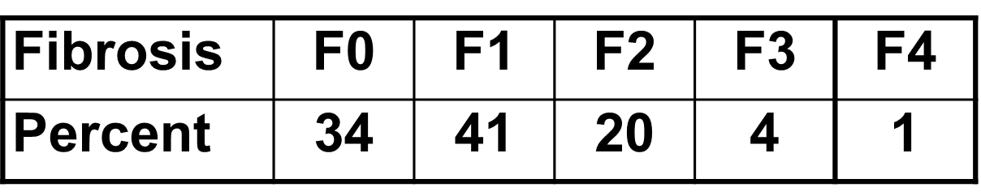
Results:
95% have F0-F2 fibrosis

Slide 8
RESULTS:
95% have F0-F2 fibrosis

Slide 9
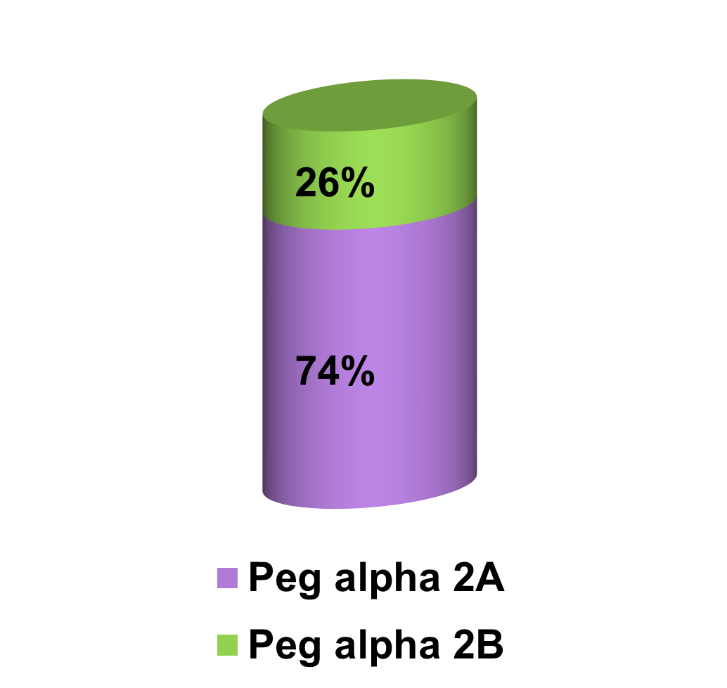
RESULTS:

Slide 10
RESULTS:
Sofosbuvir/Ledipasvir
100%SVR

Slide 11

RESULTS:

Slide 12
DISCUSSIONS:
Because of low fibrosis many HCV viremic IDUs patients were not eligible for DAA treatment. However 42 patients have bought the “generic” treatment and all have SVR.
The high proportion of undetectable HCV viral load can be explained through the “vaccination like” mechanism of acquiring the virus among IDUs and the fact that some of them had SVR from the Peg-IFN + Ribavirin therapy.

Slide 13
THANK YOU FOR YOUR ATTENTION
QUESTIONS ???

