Slide 1
Actualitati in tratamentul hepatitei cronice cu virus C
Model de ingrijire integrat pentru pacientii din grupe vulnerabile diagnosticati cu infectie cronica cu virus hepatitic C
- partea a II-a -
Spitalul Clinic de Boli Infectioase si Tropicale “Dr. Victor Babes”
Bucuresti - 06 Iunie 2018

Slide 2
Introducere
Martinot-Peignoux M, Stern C, Maylin S, et al. Twelve weeks post treatment follow-up is as relevant as
24 weeks to determine the sustained virologic response in patients with hepatitis C virus receiving pegylated
interferon and ribavirin. Hepatology. 2010;51:1122-1126.
2. Maylin S, Martinot-Peignoux M, Moucari R, et al. Eradication of hepatitis C virus in patients
successfully treated for chronic hepatitis C. Gastroenterology. 2008;135:821-829.
3. Afdhal N, Everson GT, Calleja JL, et al. Effect of viral suppression on hepatic venous pressure gradient
in hepatitis C with cirrhosis and portal hypertension. J Viral Hepat. 2017;24:823-831.
Scopul terapiei: SVR (1)
SVR este considerat echivalent cu vindecarea (2)
Eradicarea virusului este asociata cu regresia fibrozei, reversia cirozei, ameliorarea supravietuirii si scaderea ratei complicatiilor (3)

Slide 3
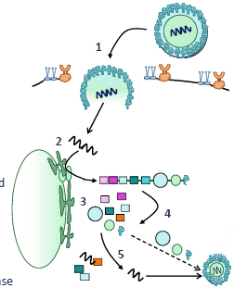
Adeziunea si patrunderea in celula
Eliberarea ARN si migrarea spre RE
Translatia si productia poliproteinei
Scindarea poliproteinei sub actiunea proteazelor in proteine structurale si non-structurale
Replicarea ARN cu ajutorul polimerazei

Slide 4
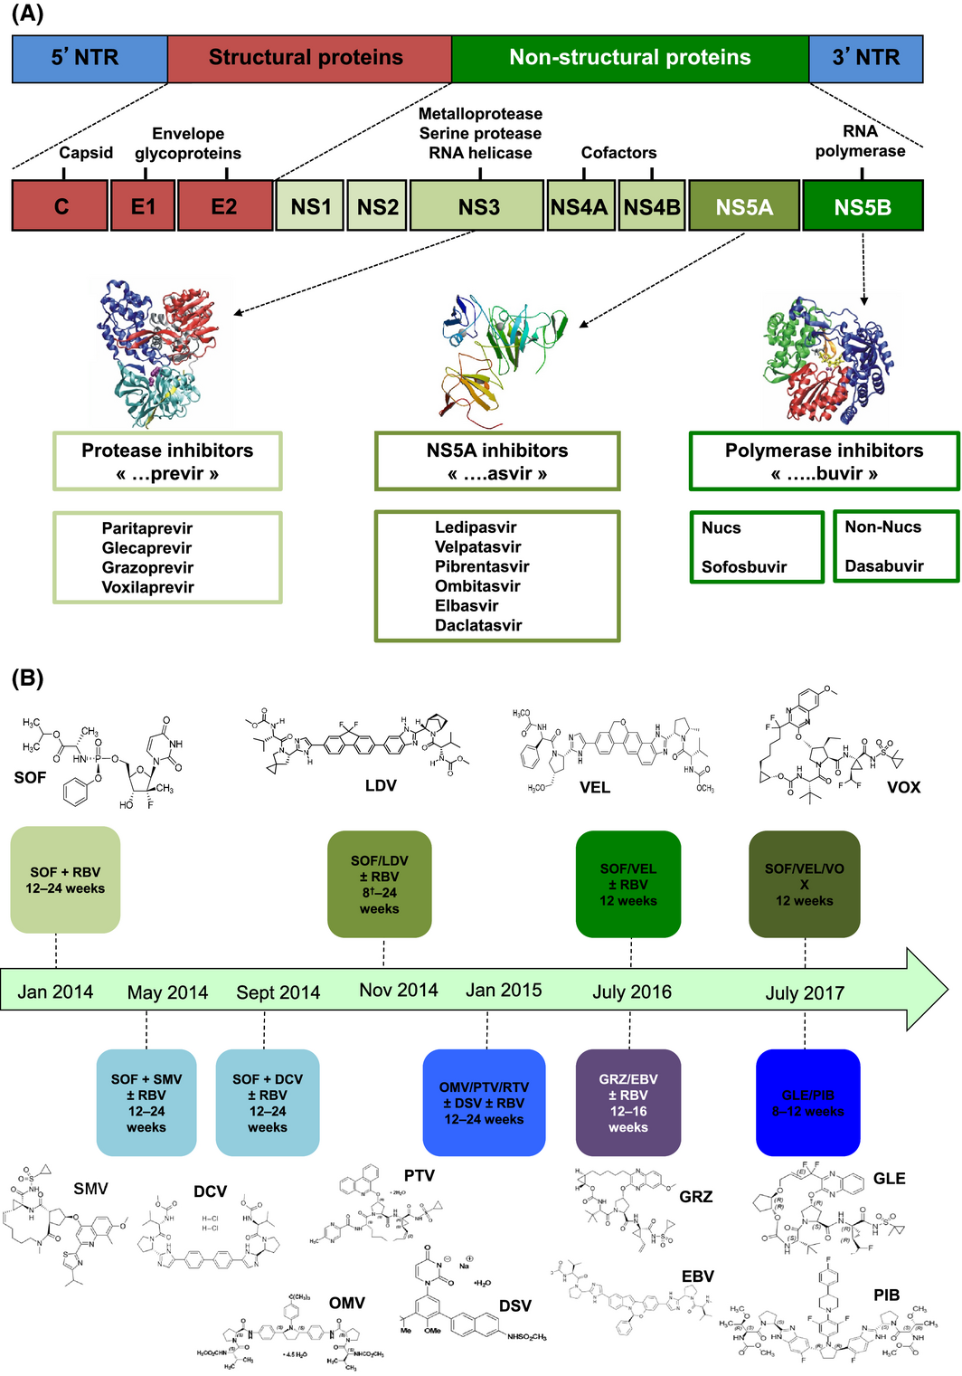
Liver International
pages 7-13, 10 FEB 2018 DOI: 10.1111/liv.13673
http://onlinelibrary.wiley.com/doi/10.1111/liv.13673/full#liv13673-fig-0002

Slide 5
Liver International
pages 7-13, 10 FEB 2018 DOI: 10.1111/liv.13673
http://onlinelibrary.wiley.com/doi/10.1111/liv.13673/full#liv13673-fig-0002

Slide 6
Beneficiile clinice ale obtinerii SVR
Reducerea necroinflamatiei
Oprirea progrsiei fibrozei/reversia fibrozei
Previne ciroza si complicatiile acesteia
Previne aparitia HCC
Reduce manifestarile extrahepatice
Creste supravietuirea
Imbunatateste calitatea vietii

Slide 7
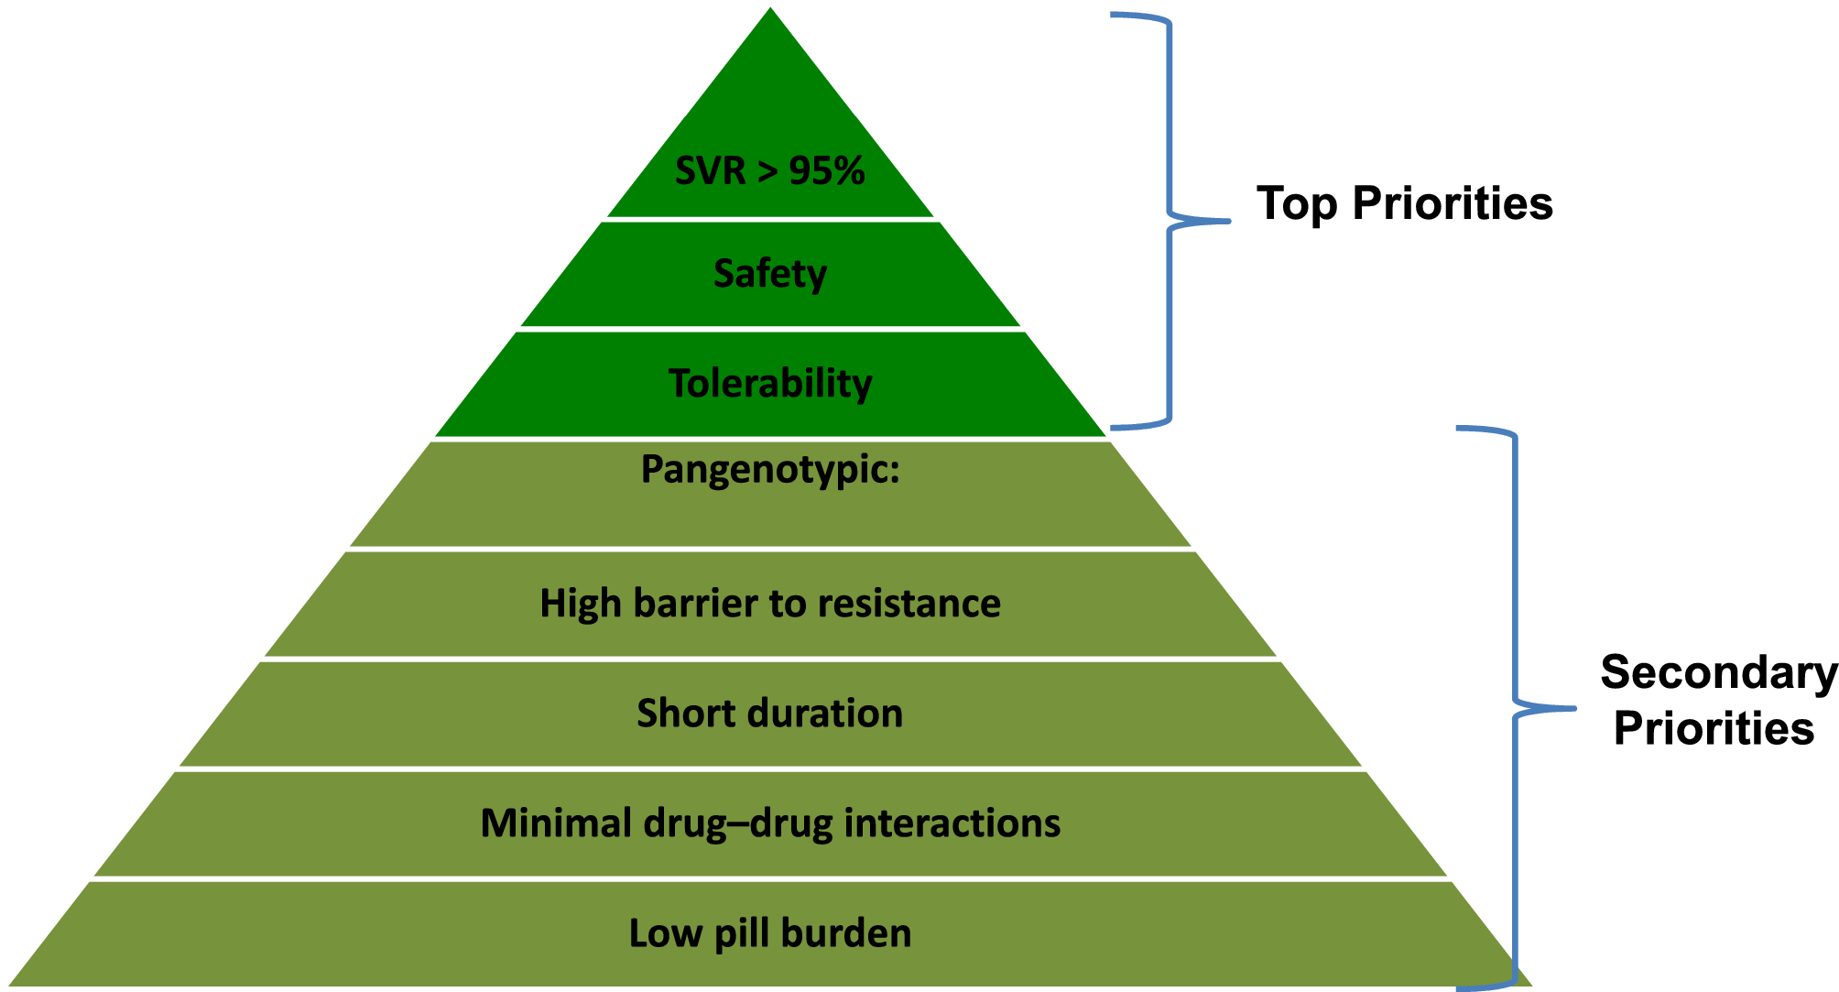
Liver International
pages 7-13, 10 FEB 2018 DOI: 10.1111/liv.13673
http://onlinelibrary.wiley.com/doi/10.1111/liv.13673/full#liv13673-fig-0002

Slide 8
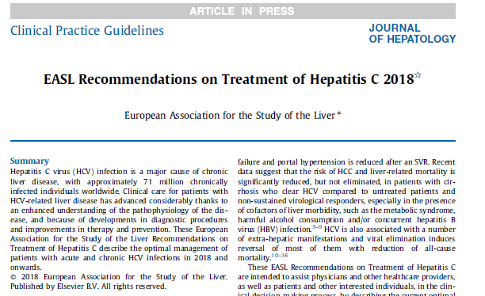

Slide 9
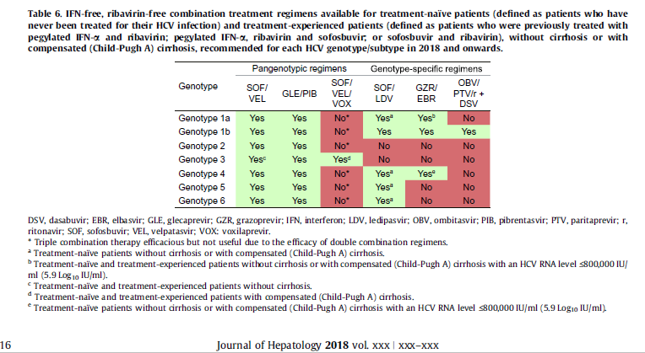
EASL 2018

Slide 10
SOFOSBUVIR/VELPATASVIR

Slide 11
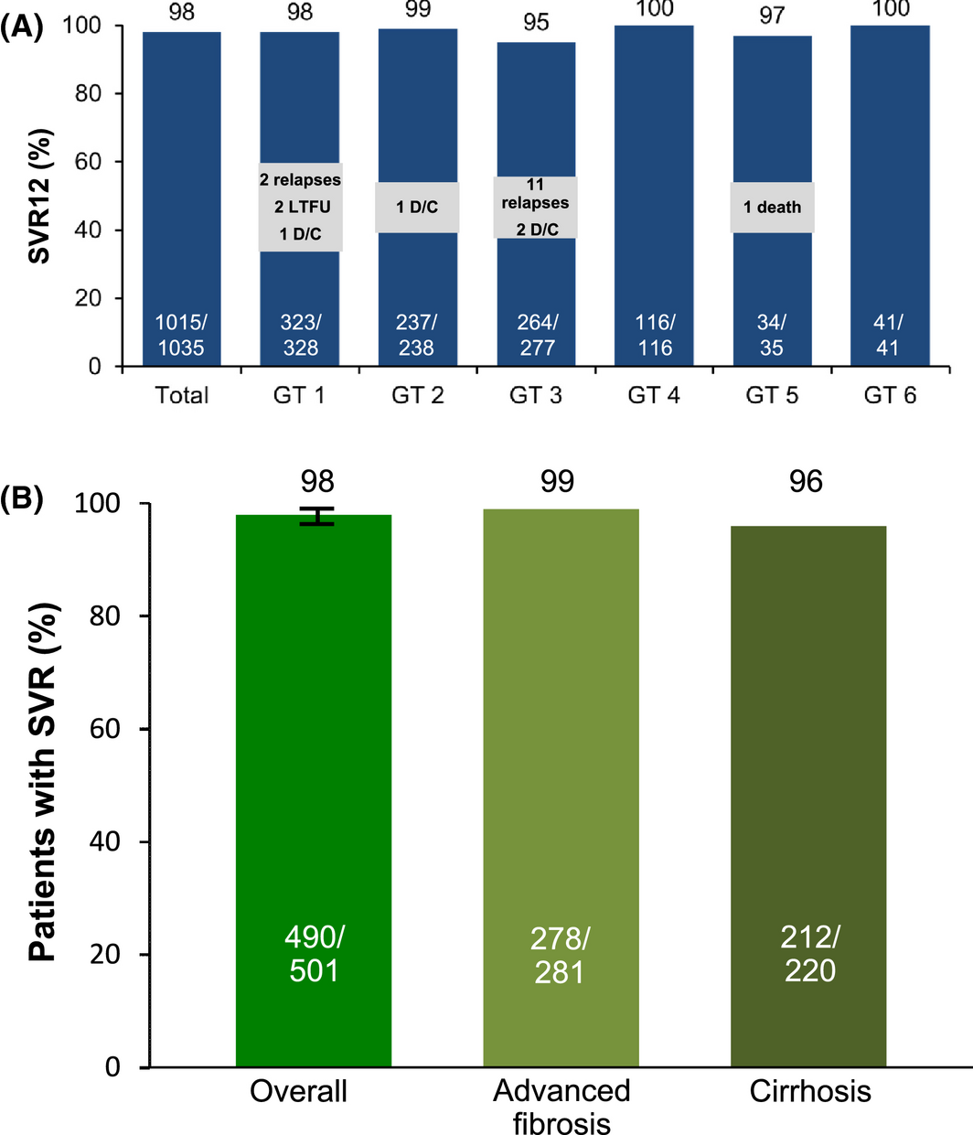
SOFOSBUVIR/VELPATASVIR
- Combinatie pangenotipica de inhibitor NS5B si NS5A
Liver International
pages 7-13, 10 FEB 2018 DOI: 10.1111/liv.13673
http://onlinelibrary.wiley.com/doi/10.1111/liv.13673/full#liv13673-fig-0002
Notes:
(A) SOF/VEL SVR rates for 12 weeks across all genotypes (ASTRAL‐1‐2‐3). These studies encompassed a broad range of HCV populations, including HCV genotypes 1–6. The overall SVR rate in more than 1000 patients was high, with 98% achieving SVR12. AE, adverse event; D/C, discontinuation; LTFU, lost to follow‐up; SAE, serious adverse event. (B) Sustained virological response rates overall and by cirrhosis or advanced fibrosis status. (ASTRAL‐1‐2‐3). SVR12 was achieved by 98% of patients (490/501; 95% CI, 96‐99). Patients with cirrhosis had an SVR12 rate of 96% (212/220), and those with advanced fibrosis had an SVR12 rate of 99% (278/281)
IF THIS IMAGE HAS BEEN PROVIDED BY OR IS OWNED BY A THIRD PARTY, AS INDICATED IN THE CAPTION LINE, THEN FURTHER PERMISSION MAY BE NEEDED BEFORE ANY FURTHER USE. PLEASE CONTACT WILEY'S PERMISSIONS DEPARTMENT ON PERMISSIONS@WILEY.COM OR USE THE RIGHTSLINK SERVICE BY CLICKING ON THE 'REQUEST PERMISSIONS' LINK ACCOMPANYING THIS ARTICLE. WILEY OR AUTHOR OWNED IMAGES MAY BE USED FOR NON-COMMERCIAL PURPOSES, SUBJECT TO PROPER CITATION OF THE ARTICLE, AUTHOR, AND PUBLISHER.

Slide 12
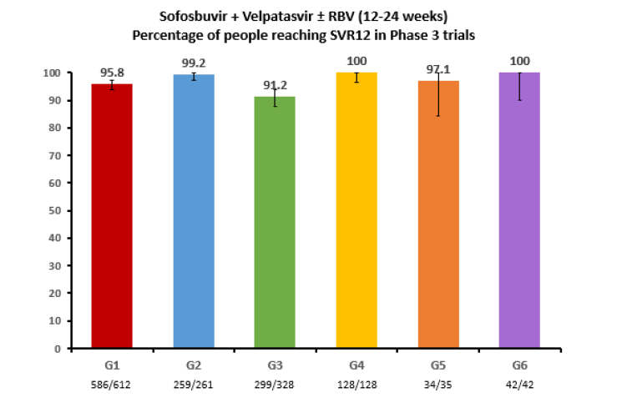
SOFOSBUVIR/VELPATASVIR
Sofosbuvir/Velpatasvir for the treatment of Hepatitis C - Application for inclusion on the WHO Model List of Essential Medicines (EML)

Slide 13
SOFOSBUVIR/VELPATASVIR
Liver International
pages 7-13, 10 FEB 2018 DOI: 10.1111/liv.13673
http://onlinelibrary.wiley.com/doi/10.1111/liv.13673/full#liv13673-fig-0002

Slide 14
GLECAPREVIR-PIBRENTASVIR

Slide 15
GLECAPREVIR-PIBRENTASVIR
(Next-Gen)
Glecaprevir – inhibitor potent NS3/4A pangenotipic eficientpe majoritatea NS3 RAS
Pibrentasvir – inhibitor potent NS5A pangenotipic eficientpe majoritatea NS5A RAS

Slide 16
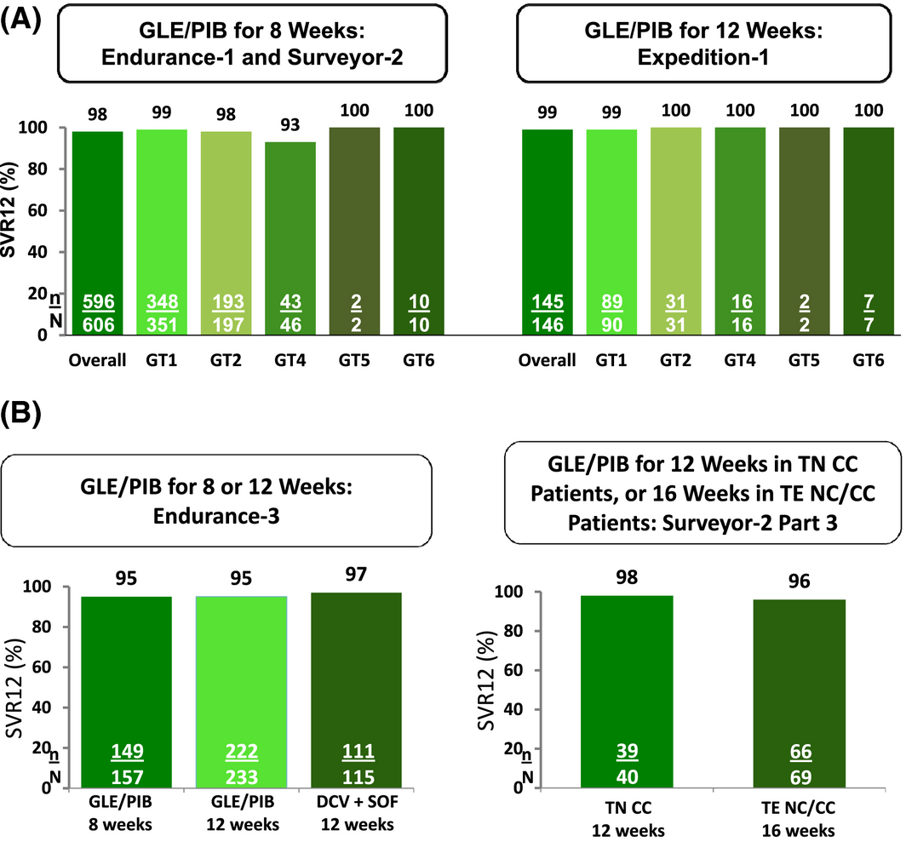
GLECAPREVIR-PIBRENTASVIR
(Next-Gen)
Liver International
pages 7-13, 10 FEB 2018 DOI: 10.1111/liv.13673
http://onlinelibrary.wiley.com/doi/10.1111/liv.13673/full#liv13673-fig-0003
Notes:
(A) Studies evaluating the efficacy of GLE/PIB in patients with HCV GT1, 2, 4‐6 Infection with or without compensated cirrhosis. GLE/PIB for 8 weeks (Endurance‐1 and Surveyor‐2) in patients without cirrhosis resulted overall in an SVR of 98% (596/606); and for GT1 an SVR of 99% (348/351). (B) Studies evaluating the efficacy of GLE/PIB in patients with HCV GT3 infection with or without compensated cirrhosis. Genotype 3‐infected patients treated for 12 weeks achieved an SVR12 rate of 95.3% with GLE/PIB, compared to a 96.5% SVR12 rate with SOF/DCV; 8‐week GLE/PIB yielded an SVR12 rate of 94.9%
IF THIS IMAGE HAS BEEN PROVIDED BY OR IS OWNED BY A THIRD PARTY, AS INDICATED IN THE CAPTION LINE, THEN FURTHER PERMISSION MAY BE NEEDED BEFORE ANY FURTHER USE. PLEASE CONTACT WILEY'S PERMISSIONS DEPARTMENT ON PERMISSIONS@WILEY.COM OR USE THE RIGHTSLINK SERVICE BY CLICKING ON THE 'REQUEST PERMISSIONS' LINK ACCOMPANYING THIS ARTICLE. WILEY OR AUTHOR OWNED IMAGES MAY BE USED FOR NON-COMMERCIAL PURPOSES, SUBJECT TO PROPER CITATION OF THE ARTICLE, AUTHOR, AND PUBLISHER.

Slide 17
ELBASVIR/GRAZOPREVIR

Slide 18
ELBASVIR/GRAZOPREVIR
Grazoprevir– inhibitor potent NS3/4A genotipuri 1 si 4 eficient pe majoritatea NS3 RAS (Resistance Associated Substitutions)
Elbasvir– inhibitor potent NS5A genotipuri 1 si 4 eficient pe majoritatea NS5A RAS
SVR12 – 96-100% - diferente in functie de fibroza, status pretratat/nu
Se pot administra si in insuficienta renala

Slide 19
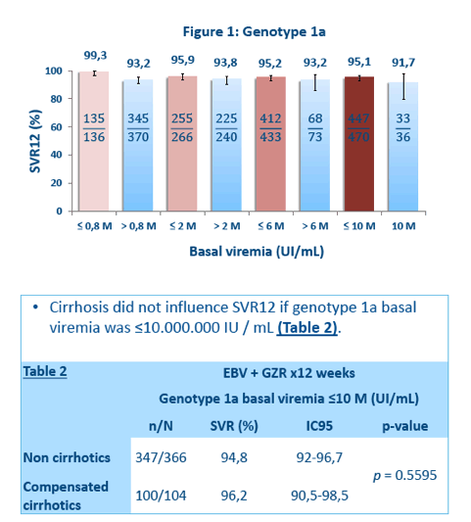
ELBASVIR/GRAZOPREVIR
Sulkowski M, Hezode C, Gerstoft J, Vierling JM, Mallolas J, Pol S, et al. Efficacy and safety of 8 weeks versus 12 weeks of treatment with grazoprevir (MK-5172) and elbasvir (MK-8742) with or without ribavirin in patients with hepatitis C virus genotype 1 mono-infection and HIV/hepatitis C virus co-infection (C WORTHY): a randomized, open-label phase 2 trial. Lancet. 2015 Mar 21; 385(9973):1087-97.

Slide 20
SOFOSBUVIR/VELPATASVIR/
VOXILAPREVIR

Slide 21
SOFOSBUVIR/VELPATASVIR/VOXILAPREVIR
Voxilaprevir – inhibitor NS3/4A pangenotipic
Profil de rezistenta imbunatatit fata de predecesori
SOF/VEL/VOX nu a indeplinit criteriul de non-inferioritate in administrarea de 8 saptamani comparativ cu SOF/VEL 12 saptamani
Are rezultate mai bune pe GT3 comparativ cu SOF/VEL

Slide 22
SOFOSBUVIR/LEDIPASVIR

Slide 23
SOFOSBUVIR/LEDIPASVIR
Regim activ pe genotipurile 1,4,5 si 6
Rate de succes peste 95% in terapii cu durata de 8-24 de saptamani

Slide 24
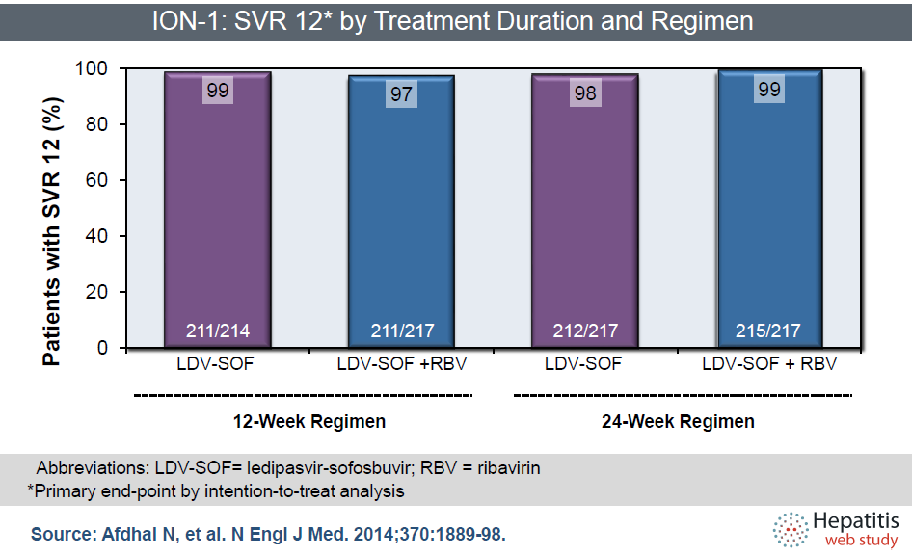
SOFOSBUVIR/LEDIPASVIR

Slide 25
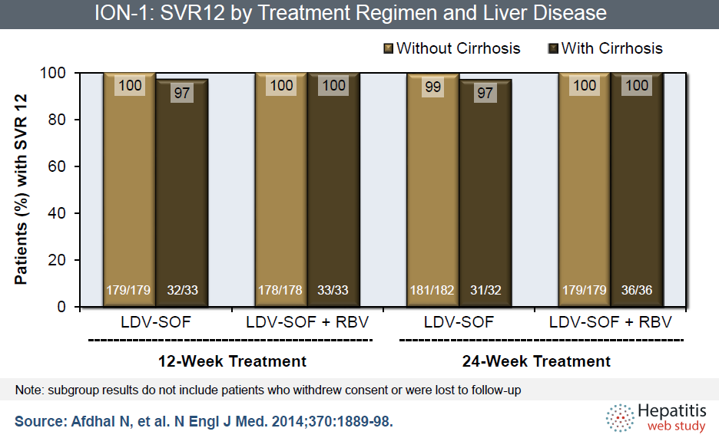
SOFOSBUVIR/LEDIPASVIR

Slide 26
OMBITASVIR/PARITAPREVIR-RITONAVIR
+
DASABUVIR

Slide 27
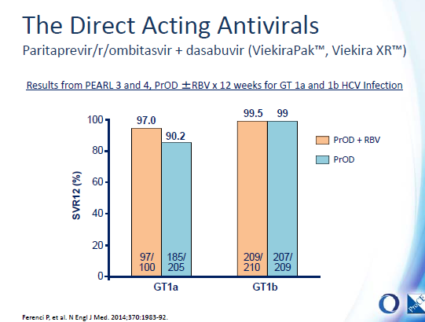
OMBITASVIR/PARITAPREVIR-RITONAVIR
+
DASABUVIR

Slide 28
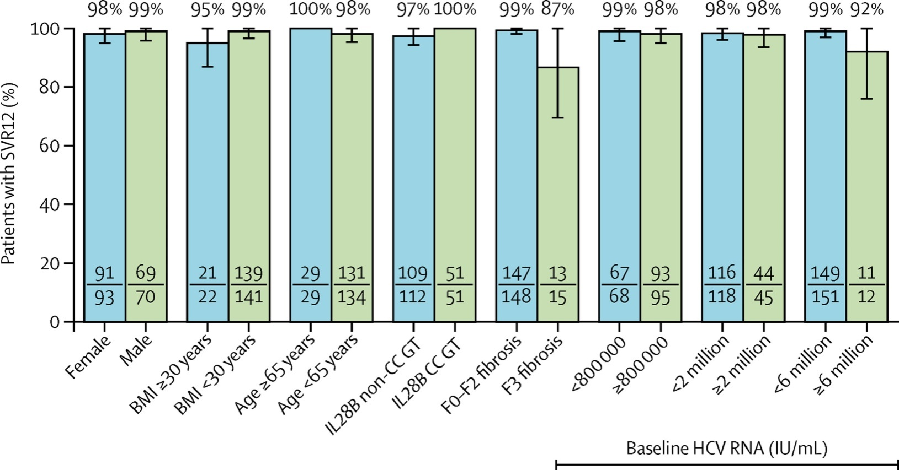
OMBITASVIR/PARITAPREVIR-RITONAVIR
+
DASABUVIR

Slide 29
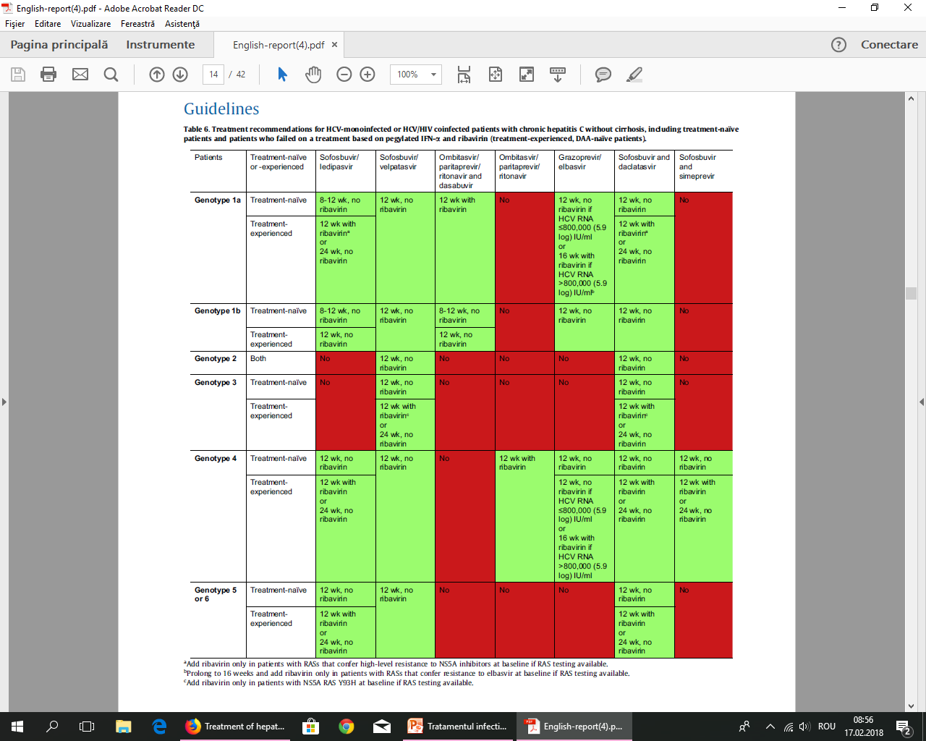
EASL 2016

Slide 30
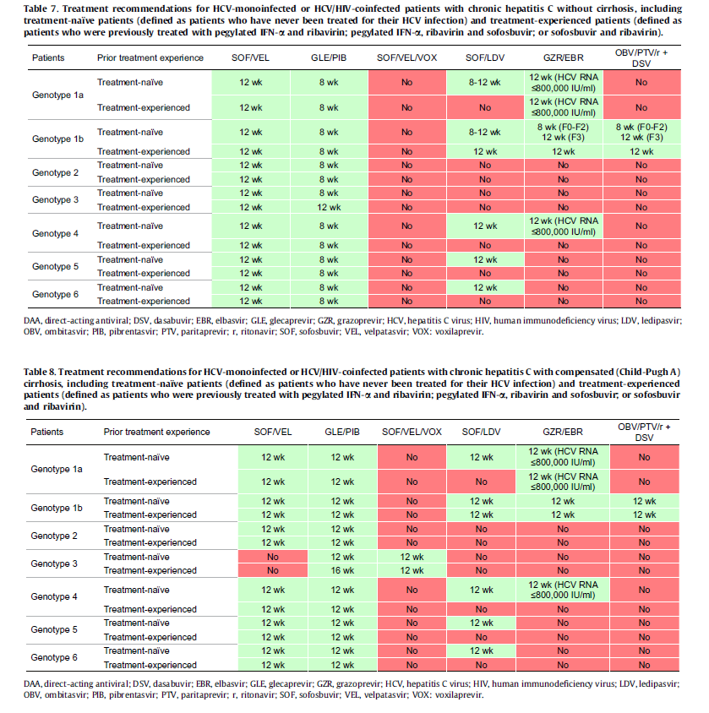
EASL 2018

Slide 31
RETRATAMENTUL PACIENTILOR
CU ESEC TERAPEUTIC
Necesita confirmarea compliantei
Sunt disponibile teste pentru RAS
Pentru pacientii cu RAS detectate se vor folosi terapii adaptate, utilizand noile regimuri

Slide 32
CONCLUZII
Ultimii ani au adus o adevarata revolutie in tratamentul infectiei VHC
Ratele de succes se apropie de 100%
Durata terapiei 8-12 saptamani
Profil de siguranta si tolerabilitate bune

Slide 33

Eliminarea hepatitei cu virus C – un țel realist?

Slide 34
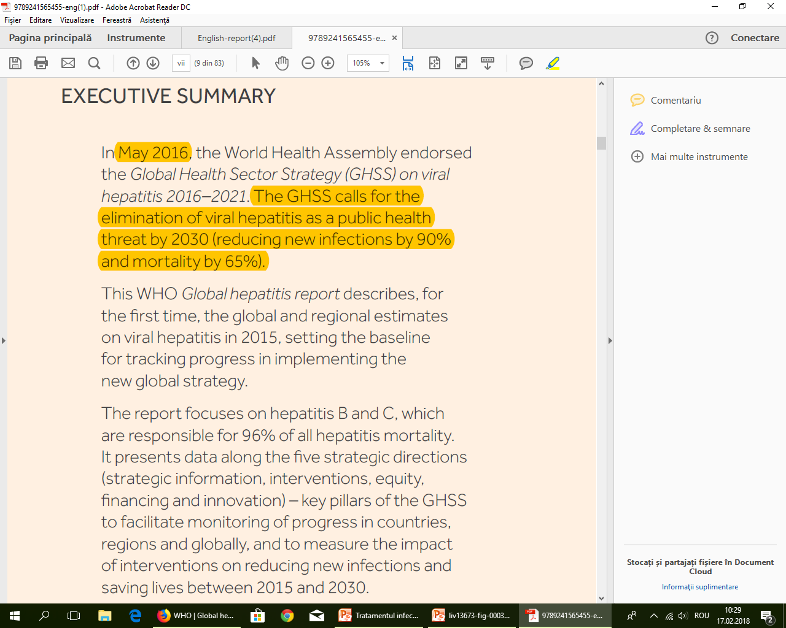

Slide 35
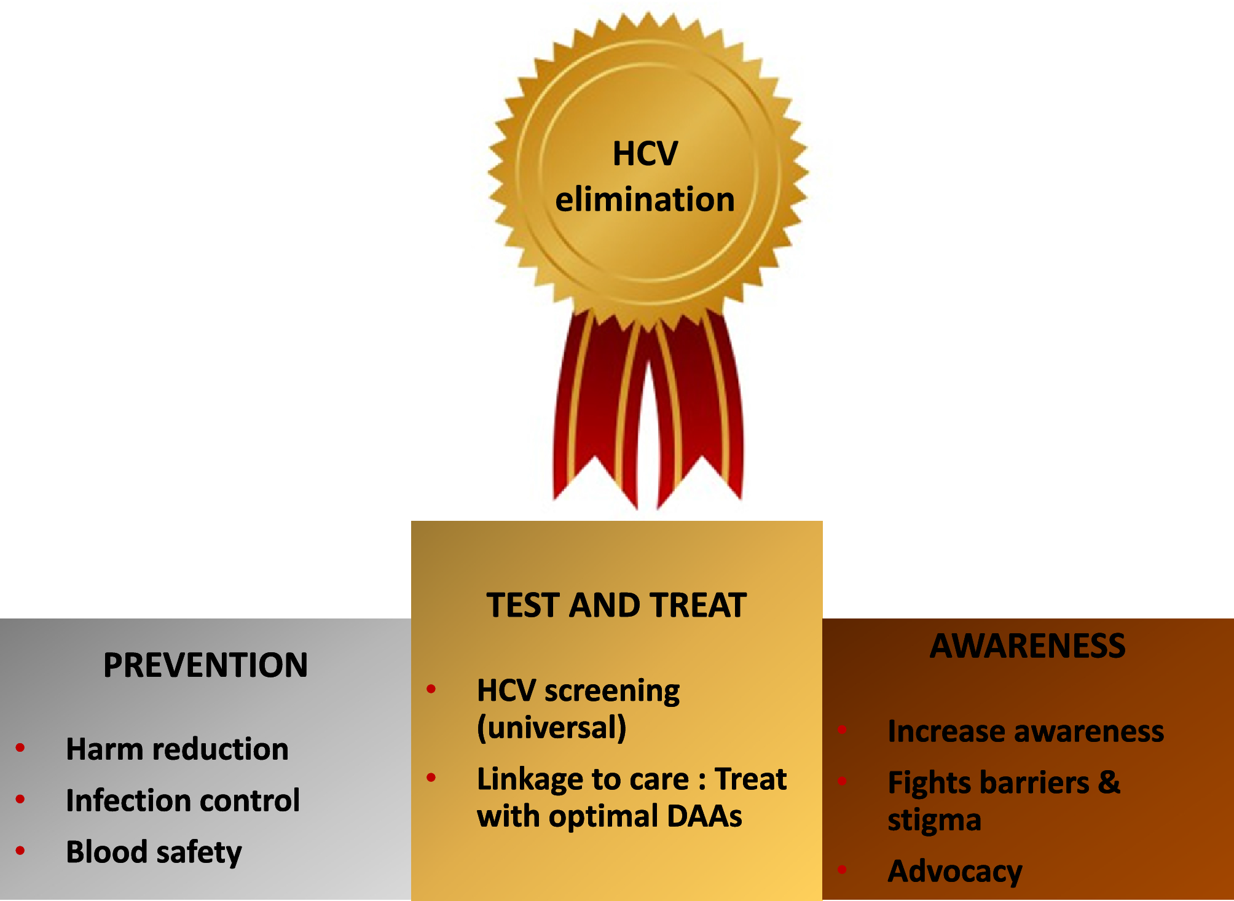
Liver International
pages 7-13, 10 FEB 2018 DOI: 10.1111/liv.13673
http://onlinelibrary.wiley.com/doi/10.1111/liv.13673/full#liv13673-fig-0002

Slide 36
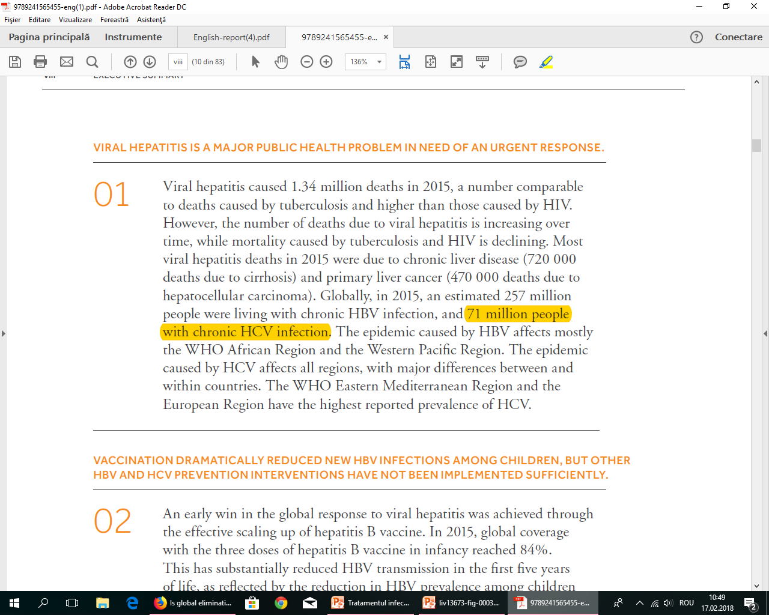
WHO (2015):
71 milioane persoane infectate cronic cu VHC (1% din populatie)
2.3 milioane coinfectati cu HIV
HCV – cauza de deces pentru 400.000 persoane
5.5 milioane tratati antiviral (500.000 tratati cu DAA)
World Health Organization. Global health sector strategy on viral hepatitis, 2016–2021: towards ending viral hepatitis. 2016. Available from http://apps.who.int/iris/bitstream/10665/246177/1/WHO-HIV-2016.06-eng.pdf. Accessed February 2018.

Slide 37
Distributia globala variaza pe regiuni
Distributia variaza si pe grupe de varste
Italy, Romania, Spain, Germany, France, UK, Poland, Greece and Bulgaria account for more than 80% of all European HCV infections, with Romania and Latvia having the highest prevalence (2.5% and 2.2% respectively)
Strategiile de eliminare trebuie sa tina cont de particularitatile epidemiologice ale infectiei VHC

Slide 38
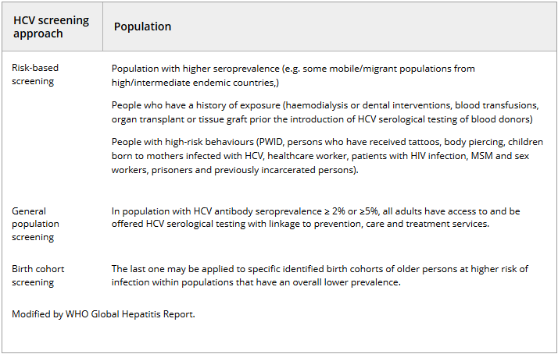
STRATEGII DE SCREENING

Slide 39
TESTAREA
Recomandari de testare:
Testare initiala EIA HCV – Se, Sp 99%
HCV RNA pentru confirmare
Unde nu este disponibil PCR – Ac anti HCV core
Teste rapide pentru detectia Ac anti HCV si HCV RNA – performante bune

Slide 40
ACCESUL LA TERAPIE SI REDUCEREA BARIERELOR
Un posibil efect nedorit al intensificarii screeningului ar fi stigmatizarea
De aceea e nevoie ca pacientii diagnosticati sa aiba acces la tratament
Exista totusi schisme intre diagnostic si tratament:
  Costurile mari
  Accesibilitatea la personal calificat pentru tratament
  Utilizatorii de droguri, substante psihotrope
  Pacientii psihiatrici
  Persoanele fara locuinta
  Detinutii
! Necesitatea abordarii pluridisciplinare si in colaborare cu serviciile sociale

Slide 41
BARIERE CLINICE
Rata de scucces la prima terapie peste 95%, in general 97%
Aproximativ 3% esecuri la prima terapie
90% dintre esecuri pot fi retratati cu alte regimuri, cu succes

Slide 42
CONCLUZII
Prevalenta mare a infectiei VHC precum si disponibilitatea noilor regimuri DAA au condus la adoptarea rezolutiei de eliminare a infectiei VHC ca amenintare de sanatate publica pana in 2030
Trebuie tinut cont de particularitatile epidemiologice ale infectiei VHC
Screeningul este o componenta centrala a acestei strategii
Utilizarea testelor rapide poate imbunatati acest proces
Exista obstacole, care pot fi insa depasite

Slide 43


